Slide 1





HackOrbit 2025
THE ORIGINALS

Slide 2

THEME: AI & ML
Title: ResumAI - Scan. Optimize. Get Hired.
Job seekers often get rejected due to poorly optimized resumes that don’t match job descriptions. There's a need for an AI-powered tool that can scan, enhance, and personalize resumes using Generative AI and LLMs to improve hiring chances.

Slide 3
PROPOSED SOLUTION
ResumAI is an AI-powered platform that leverages Generative AI and Large Language Models (LLMs) to assist job seekers in creating highly optimized and personalized resumes tailored to specific job roles. The platform offers an end-to-end solution:
1. Resume Scanning & Analysis:
Users upload or paste their existing resume.
The system analyzes structure, language, formatting, skills, and keyword alignment with current industry standards.
2. Job Description Matching:
Users can upload a job description (JD) or select their target role.
The AI compares the resume with the JD to identify missing skills, relevant keywords, and weak sections.
3. AI-Powered Optimization Suggestions:
Using LLMs (like GPT-based models), the system generates role-specific improvement suggestions.
Offers rewritten content for experience, skills, and summary sections to enhance relevance and clarity.
4. Personalized Resume Generation:
Allows users to regenerate sections or the entire resume with AI assistance.
Supports multiple versions for different job applications.
5. Smart Resume Scoring:
Resumes are scored based on ATS (Applicant Tracking System) compatibility, keyword density, grammar, and role match.
Feedback is given with actionable tips for improvement.
6. Job Role Recommendations:
Based on the resume content and user preferences, the platform recommends relevant job listings from integrated APIs (optional).
AI suggests minor tweaks to better fit job trends.
7. User-Friendly Interface:
A clean, intuitive UI for uploading resumes, reviewing suggestions, editing content, and downloading final versions.

Slide 4
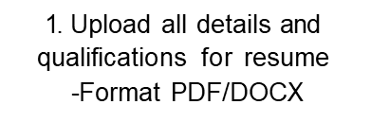
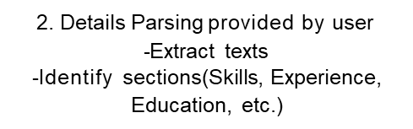
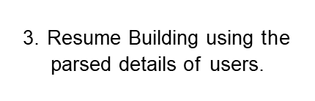
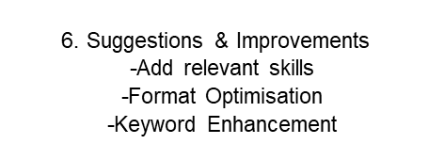



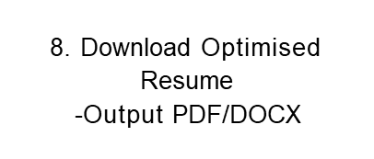
WORKFLOW DIAGRAM
5.Job Matching
-Fetch Job listings(API/scraping)
-Match Resume with Job
4.AI Analysis
-Detect missing keywords
-Check formatting consistency

Slide 5
Workflow – Explained
The ResumAI platform follows a structured 8-step workflow to help users create optimized, AI-enhanced resumes matched to relevant job opportunities.:
1. Upload Resume
Users begin by uploading their resume in PDF or DOCX format.
This resume contains all essential personal, educational, and professional details.
2. Parsing Resume Details
The system parses the uploaded file and extracts key sections such as Skills, Experience, Education, Certifications, etc., either automatically or based on user input.
3. Resume Building
Parsed information is organized into a structured format, preparing it for further analysis and enhancements.
This ensures a clean and consistent base resume.
4. AI Analysis
Generative AI analyzes the resume for:
Missing or weak keywords compared to target job roles.
Formatting consistency issues.
Skill gap detection, checking alignment with industry expectations.
5. Job Matching
Using API integrations or web scraping, the system fetches real-time job listings. It then compares the user’s resume with job descriptions to:
Identify matching job roles.
Recommend relevant opportunities.
6. Suggestions & Improvements
Based on AI insights and job match results, the system suggests:
Adding missing but relevant skills
Improving formatting for readability and ATS compliance
Enhancing keywords and phrasing to boost relevance
7. Resume Scoring
Two types of scores are generated:
Resume Quality Score – based on structure, language, and AI feedback
Job Fit Score – based on how well the resume aligns with selected job roles
8. Download Optimized Resume
After applying suggested improvements, the final resume is generated and made available for download in PDF or DOCX format, ready to be used in job applications.

Slide 6
FEATURES AND NOVELTY
1. Resume Upload & Parsing
Upload resumes in PDF/DOCX and auto-extract key details like skills, education, and experience.
2. AI-Powered Resume Analysis
Analyze structure, grammar, and keyword alignment using LLMs.
3. Job Description Matching
Match resumes with job descriptions to identify relevant skills and missing keywords.
4. Generative Resume Optimization
Use Generative AI to rewrite and enhance resume sections tailored to target roles.
5. Smart Suggestions
Provide role-based tips for improving content, format, and keyword usage.
6. Scoring Mechanism
Generate Resume Quality and Job Fit scores to evaluate effectiveness.
7. Download Final Resume
Export optimized resumes in professional PDF or DOCX formats.
8. Job Role Recommendations (Optional)
Suggest matching job roles based on resume content and skillsets.
1. Generative AI-Driven Personalization
Unlike traditional resume builders, ResumAI uses LLMs (like GPT) to generate custom, human-like resume content tailored to each job role.
2. Real-Time JD Matching & Feedback
The system not only scores resumes but also matches them to live job descriptions, identifying exact mismatches and providing actionable insights.
3. Multi-Version Resume Generation
Enables users to create multiple versions of a resume for different roles, making applications more targeted and effective.
4. Skill Gap Detection using AI
Goes beyond basic suggestions by performing a deep skill gap analysis against job market requirements.
5. End-to-End Resume Optimization in One Tool
Combines resume editing, AI feedback, JD matching, and final export into a single streamlined platform — no need for separate tools.

Slide 7
DRAWBACK AND SHOWSTOPPERS
1. Over-Reliance on AI Suggestions
Users may blindly follow AI-generated content, losing personal touch or accuracy.
2. Limited Context Understanding
LLMs may misinterpret specific technical roles or domain-specific experiences.
3. No Human Review
Lacks professional human feedback, which some recruiters still value.
4. Data Privacy Concerns
Uploading personal resumes and job data could raise privacy/security issues if not handled securely.
1. Unstable or Missing AI/API Integration
If the Generative AI or job matching API fails, core features break down.
2. Incorrect Parsing of Resumes
Bad formatting or unusual layouts can lead to incorrect data extraction and faulty suggestions.
3. No Internet Access
Many features (e.g., job matching) depend on real-time web services.
4. Scalability Issues
High user load may cause performance lags if not optimized for backend processing.

Slide 8
THE ORIGINALS
Khushboo Khator (khushboocodes@gmail.com)
Tanushka Tomar (tanushkat2005@gmail.com)
Anuj Sharma (anujsharrmmaa@gamil.com)
Purnima Parihar (pariharpurnima8@gmail.com)

Slide 9
Thank
you

